Slide 1

Prestressed Concrete
Lecture 6

Slide 2
Prestressed Concrete Pipes and Tanks
Circular Prestressing: Liquid retaining structures, such as circular pipes, tanks and pressure vessels are suited for circular prestressing. The circumferential hoop compression induced in concrete by prestressing counterbalances the hoop tension developed due to the internal fluid pressure. Water storage tanks of large capacity are made of prestressed concrete. -Cylindrical tanks are by far the most used types from structural and constructional considerations. Some of the largest prestressed concrete tanks constructed are circular in shape. A cylindrical shape is well suited for circumferential wire wrapping, which constitutes the major prestressing operation in tanks.

Slide 3
Tanks Dimensions

Slide 4
Proportions

Slide 5
Tank Floors
The base slab forming the floor of the tank is made of reinforced concrete constructed on a flat bituminous surfacing or on a thin concrete binding with the interposition of a sliding layer such as oil paper, so that the slab can move over the compacted soil bed. The slab should be sufficiently flexible so that it can adapt itself to the local deformations of the pre-compacted subsoil. The reinforcements in the slab should be well distributed to control the cracking of the slab due to shrinkage and temperature changes.

Slide 6
Junctions of Wall and Base Slab
The joint between the walls of the tank and floor slab may be any one of the following three types: 1. Fixed base. 2. Hinged base. 3. Sliding base.

Slide 7
Junctions of Wall and Base Slab

Slide 8
Wire Wrapping
The most common method of wire wrapping for circular tanks consists of a traction machine, referred to as ‘merry go round’ and developed by the Preload Engineering Company. The machine is suspended from a trolley which runs along the top of the tank walls. The high-tensile wire is drawn through a die while it is wound on the tank to achieve the designed tension in the wire. As a precaution, the wires are anchored by clips in the wall at regular intervals to ensure that, in the event of wire fracture, the winding does not get detached. Joining of wires is generally done by spring loaded torpedo splices. With improvements over the years, the winding speed is about 4.5 m/s.

Slide 9
Analysis of Prestressed Concrete Tanks
The bending moments and ring tension, developed in circular water tanks due to the hydrostatic pressure, depend upon factors, such as the type of fixity between the tank wall and the base slab, the diameter of the tank, the thickness of the wall and the elastic constants of the material forming the walls. The analysis is based on Timoshenko’s general theory of cylindrical shells²⁵, with the assumption that the thickness of the tank wall is small in relation to the diameter. The vertical bending moment, M_{w}, and the ring tension, N_{d}, developed at a distance, x from the base of the tank (Fig. 16.13) are expressed as:

Slide 10
Analysis

Slide 11
Analysis

Slide 12
Analysis
Mo and No are the moment and shear acting at the base of the tank, with their values depending upon the pressure distribution and the conditions of fixity at the base. -A diagrammatic representation of the variation of bending moments and ring tension in the walls of tanks for different types of bases

Slide 13
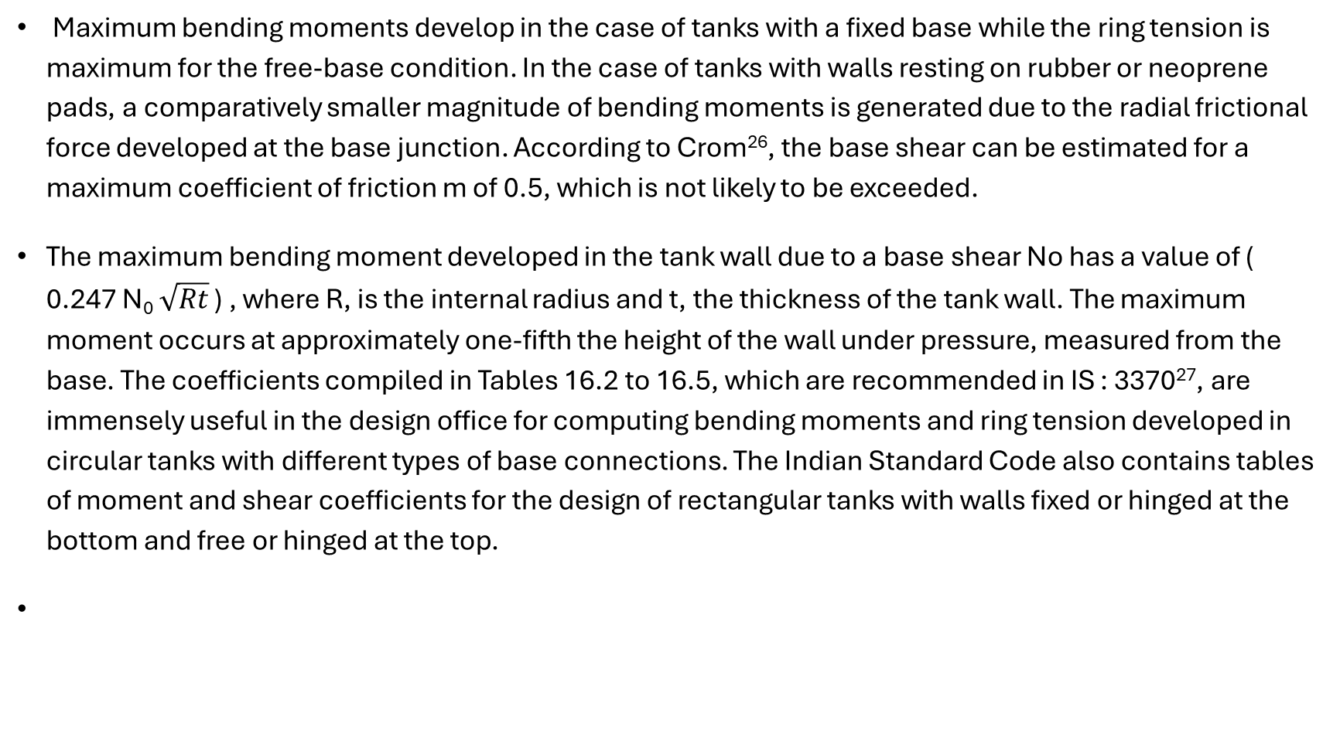
Analysis
Maximum bending moments develop in the case of tanks with a fixed base while the ring tension is maximum for the free-base condition. In the case of tanks with walls resting on rubber or neoprene pads, a comparatively smaller magnitude of bending moments is generated due to the radial frictional force developed at the base junction. According to Crom²⁶, the base shear can be estimated for a maximum coefficient of friction m of 0.5, which is not likely to be exceeded.
The maximum bending moment developed in the tank wall due to a base shear No has a value of ( 0.247 N₀ $\sqrt{Rt}$ ) , where R, is the internal radius and t, the thickness of the tank wall. The maximum moment occurs at approximately one-fifth the height of the wall under pressure, measured from the base. The coefficients compiled in Tables 16.2 to 16.5, which are recommended in IS : 3370²⁷, are immensely useful in the design office for computing bending moments and ring tension developed in circular tanks with different types of base connections. The Indian Standard Code also contains tables of moment and shear coefficients for the design of rectangular tanks with walls fixed or hinged at the bottom and free or hinged at the top.

Slide 14
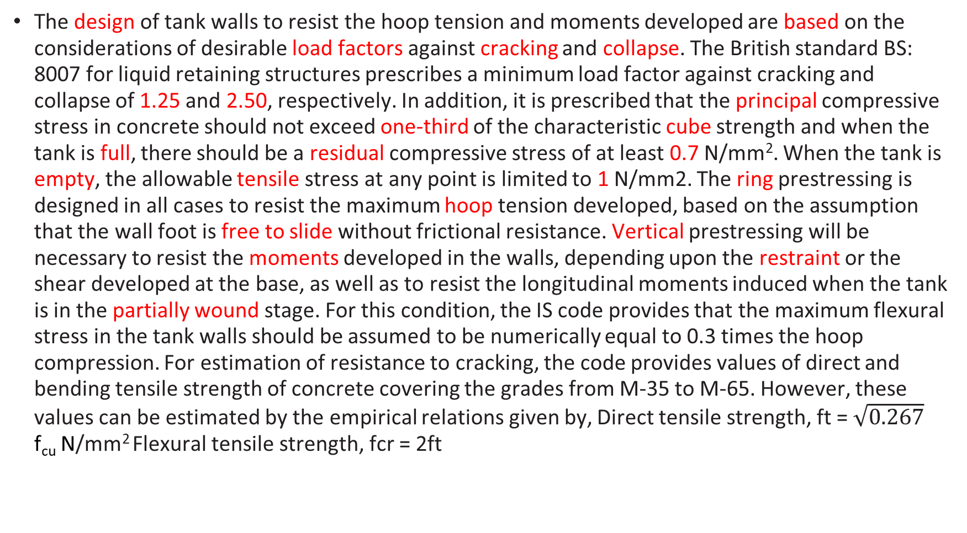
Criteria of Design
The design of tank walls to resist the hoop tension and moments developed are based on the considerations of desirable load factors against cracking and collapse. The British standard BS: 8007 for liquid retaining structures prescribes a minimum load factor against cracking and collapse of 1.25 and 2.50, respectively. In addition, it is prescribed that the principal compressive stress in concrete should not exceed one-third of the characteristic cube strength and when the tank is full, there should be a residual compressive stress of at least 0.7 N/mm². When the tank is empty, the allowable tensile stress at any point is limited to 1 N/mm2. The ring prestressing is designed in all cases to resist the maximum hoop tension developed, based on the assumption that the wall foot is free to slide without frictional resistance. Vertical prestressing will be necessary to resist the moments developed in the walls, depending upon the restraint or the shear developed at the base, as well as to resist the longitudinal moments induced when the tank is in the partially wound stage. For this condition, the IS code provides that the maximum flexural stress in the tank walls should be assumed to be numerically equal to 0.3 times the hoop compression. For estimation of resistance to cracking, the code provides values of direct and bending tensile strength of concrete covering the grades from M-35 to M-65. However, these values can be estimated by the empirical relations given by, Direct tensile strength, ft = $\sqrt{0.267}$ f_{cu} N/mm² Flexural tensile strength, fcr = 2ft

Slide 15
Design Procedure for Circular Tanks
The procedure to be followed and the design equations for the computations of the minimum wall thickness, circumferential prestress, spacing of wires and vertical prestress required are as follows: 1. Estimate the maximum ring tension, Nd, and bending moment, Mw, in the walls of the tank using the IS code (Tables 16.2 to 16.5).
2. Minimum wall thickness = = Nd/(µfct -fmin.w) The thickness of the wall provided should be such that a minimum cover of 35 mm is available to the vertical prestressing cables. In practice, the walls are seldom less than 120 mm thick to ensure proper compaction of concrete.
3. The circumferential prestress required is given by, (fc = Nd/µt + fmin.w/µ) N/mm2 4. The spacing of the wires required at any section is obtained by considerations of the hoop tension due to fluid pressure and hoop compression due to the circumferential wire winding, as follows:
If As = cross-sectional area of wire winding, mm2
wt = average radial pressure of wires at transfer at a given section, N/mm2
D = diameter of the tank, mm
s = spacing of wires at the given section, mm
fs= stress in wires at transfer, N/mm2
t = thickness of the tank wall, mm
fc= compressive stress in concrete, N/mm2

Slide 16
Design Procedure for Circular Tanks – (continued)

Slide 17
Design Procedure for Circular Tanks – (continued)
5. The vertical prestress required to resist the bending moments in the wall due to the circumferential wire winding and hydrostatic pressure as a consequence of end restraint is computed as follows: If Mt = vertical moment due to the prestress at transfer, and Mw = vertical moment due to hydrostatic pressure then Mt =

Slide 18
Example 16.5
A cylindrical prestressed concrete water tank of internal diameter 30 m is required to store water over a depth of 7.5 m. The permissible compressive stress in concrete at transfer is 13 N/mm² and the minimum compressive stress under working pressure is 1 N/mm². The loss ratio is 0.75. Wires of 5 mm diameter with an initial stress of 1000 N/mm2 are available for circumferential winding and Freyssinet cables made up of 12 wires of 8 mm diameter stressed to 1200 N/mm2 are to be used for vertical prestressing. Design the tank walls assuming the base as fixed. The cube strength of concrete is 40 N/mm².

Slide 19
Solution

Slide 20
Continued

Slide 21
Continued

Slide 22
Continued

Slide 23
Example 16.6
Design the circular cylindrical tank of Example 16.5, assuming the base connections to be hinged, with the other data remaining the same. From Tables 16.4 and 16.5 (tanks with hinged base), the maximum ring tension and moments are obtained for the tank parameter, (H2/Dt)= 12.5.

Slide 24
Continued

Slide 25
Review Questions
16.5 Explain with sketches the different shapes of prestressed concrete water tanks mentioning their advantages. 16.6 What are the different types of joints used between the walls and floor slab of prestressed concrete tanks? 16.7 Explain with sketches the distribution of ring tension and bending moment in circular tanks with fixed, sliding, and hinged base. 16.8 What minimum load factors are provided against cracking and ultimate collapse for circular water tanks in the relevant Indian codes. 16.9 What is bursting pressure? How do you calculate the factor of safety against bursting in cylinder tanks? 16.10 Explain the necessity of using vertical cables in tank walls.

